Slide 1

STATISTICS
Random variables
Discrete and continuous.
Discrete Probability Distribution

Slide 2
Random variables
A random variable is a variable whose value is unknown or a function that assigns values to each of an experiment's outcomes.
A random variable can be either discrete (having specific values) or continuous (any value in a continuous range).
The use of random variables is most common in probability and statistics, where they are used to quantify outcomes of random occurrences.
Risk analysts use random variables to estimate the probability of an adverse event occurring.

Slide 3
Random variables
Random variables are often used in econometric or regression analysis to determine statistical relationships among one another.
A random variable can be either discrete or continuous.
A random variable is called discrete if it has either a finite or a countable number of possible values.
A random variable is called continuous if its possible values contain a whole interval of numbers.

Slide 4
Random variables
Types of Random Variables
Discrete
continuous

Slide 5
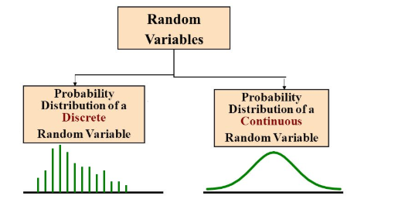

Random variable
In other words, for a discrete random variable X, the value of the Probability Mass Function P(x) is given as,
P(x)= P(X=x)
If X, discrete random variable takes different values x1, x2, x3……
Then,
And 0 <= p(xi) <=1

Slide 6
Discrete random variable
Discrete random variables take on a countable number of distinct values.
A discrete variable is a type of statistical variable that can assume only fixed number of distinct values and lacks an inherent order.
If all the possible values of a random variable can be listed along with the probability for each value, then such a variable is said to be a
Discrete random variable also known as a categorical variable, because it has separate, invisible categories. However no values can exist in-between two categories, i.e. it does not attain all the values within the limits of the variable. So, the number of permitted values that it can suppose is either finite or countably infinite. Hence if you are able to count the set of items, then the variable is said to be discrete.

Slide 7
Discrete random variable
Example
Flip a coin 3 times. The possible outcomes for each flip are Heads (H) and Tails (T).
According to the counting rule 1, there are total eight possible outcomes (2*2*2).
These outcomes are TTT, TTH, THT, HTT, HHT, THH and HHH. Suppose we are interested in number of heads.
Let
A = Event of observing 0 heads in 3 flips (TTT)
B = Event of observing 1 head in 3 flips (TTH, THT, HTT)
C = Event of observing 2 heads in 3 flips (HHT, HTH, THH)
D = Event of observing 3 heads in 3 flips (HHH)

Slide 8
Discrete probability distribution
A discrete probability distribution lists each possible value the random variable can assume, together with its probability. A probability distribution must satisfy the following conditions.
The probability of each value of the discrete random variable is between 0 and 1, inclusive.
The sum of all the probabilities is 1.

Slide 9
Discrete probability distribution
The value of the random variable X is not known in advance, but there is a probability associated with each possible value of X.
The list of all possible values of a random variable X and their corresponding probabilities is a probability distribution.

Slide 10
Continuous random variables
Continuous random variable is a variable, for which any value is possible over some range of values.
For a random variable of this type, there are no gaps in the set of possible values.

Slide 11
Continuous random variables
Example:
continuous random variable would be an experiment that involves measuring the amount of rainfall in a city over a month
Where
X = Number of days it rained in Chennai during August.
Y = Amount of rainfall during this month
Here X is a discrete random variable, because there are gaps in the possible values and Y is a continuous random variable as any value is possible over a particular range.

Slide 12
Continuous random variables
There are 3 popular methods of describing the probabilities associated with a discrete random variable
List each value of X and its corresponding probability.
Use a histogram to convey the probabilities corresponding to the various values of X.
Use a function that assigns a probability to each value of x.

Slide 13
Thank you

